Slide 1






Foreign Languages Section
Report on 2024-25

Slide 2






Curriculum Development
The FL Programme Coordinators have reviewed all courses
and proposed changes.
New textbooks for GERM1005 and SPAN1005 in AY25/26
A new German elective course titled ‘Cinematic Germany:
Analysing History, Culture and Social Issues through
Postmodern German Films’ in AY25/26
Japanese assessment design has been refined
Engaged French-speaking students to produce learning
materials and conduct class visits
AI and digital tools have been integrated in teaching
and learning
85.3% of foreign language students reported using AI and
digital tools for foreign language learning

Slide 3

LAnguage Enhancement Programme
Language Courses/Workshops
German I
Japanese I
Korean I
Spanish I
German Pronunciation
German Sentence Structures
Introduction to the Spanish Language
Japanese Phonological Features: Vowel Devocalization
Japanese Intonation
The On and Kun Readings of Kanji
Japanese Particles, Adverbs
Interest/Practical Courses
Explore Paris and France
Order Food and Drinks in French
Survival French for Travellers

Slide 4


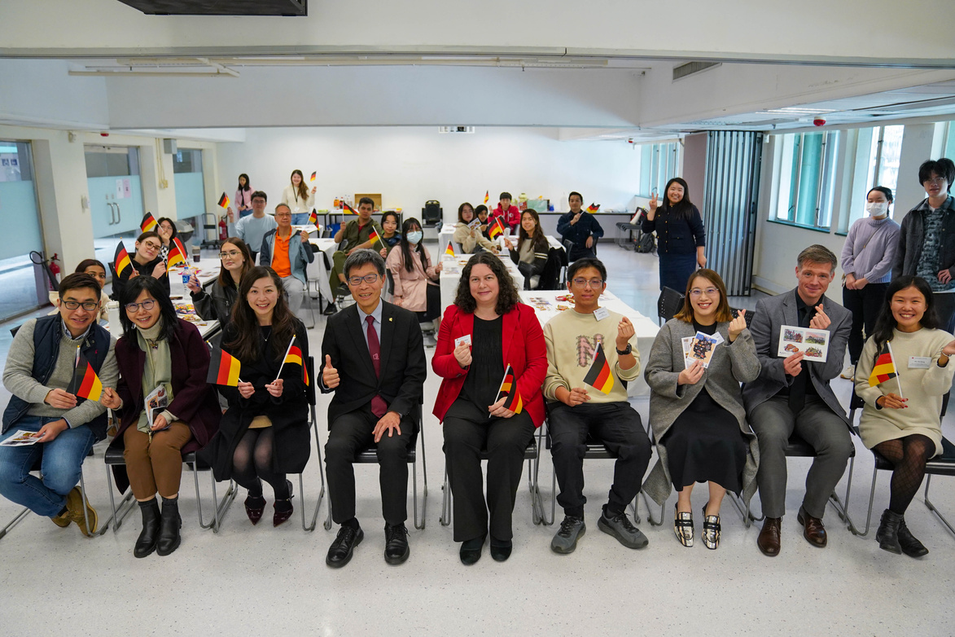
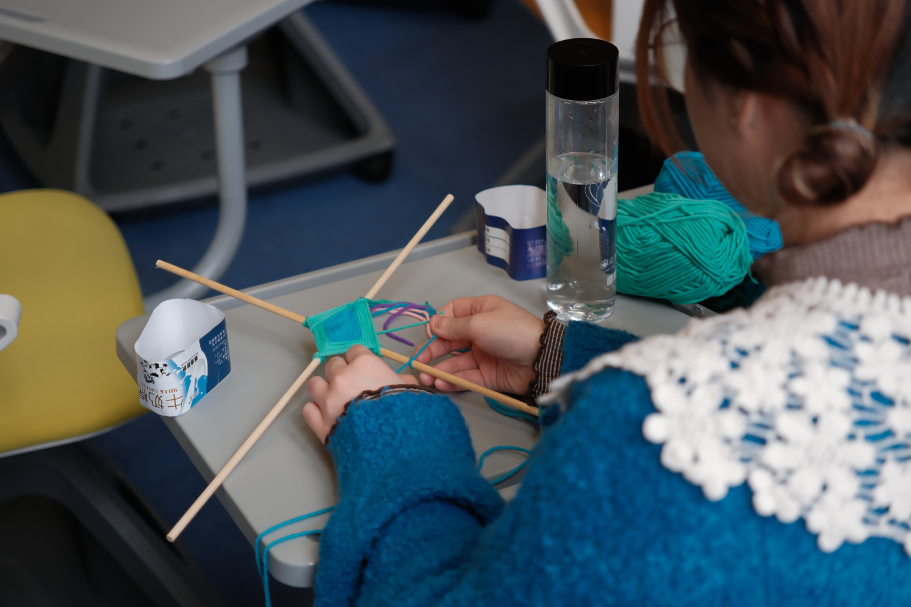
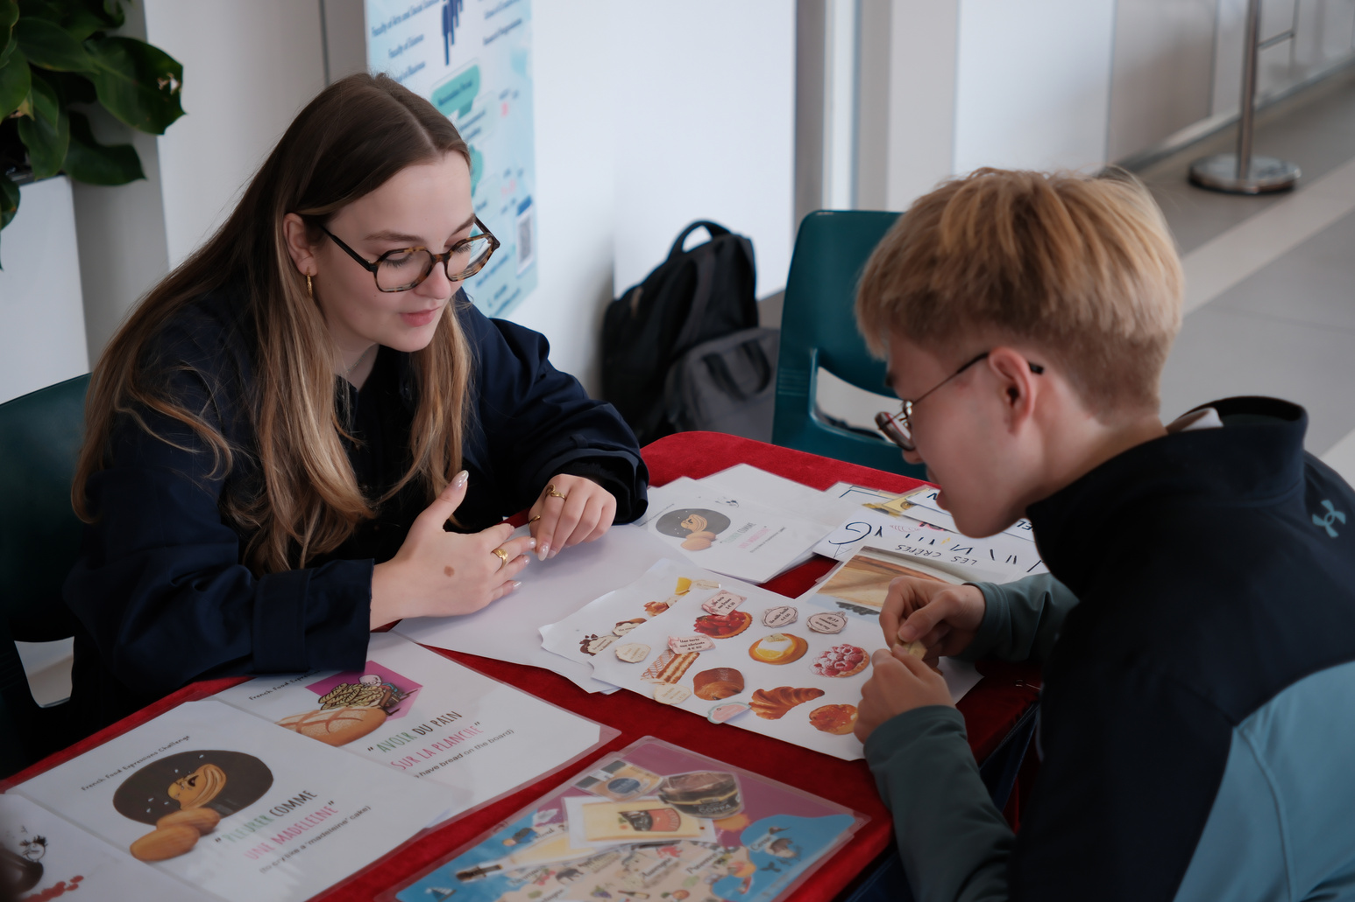
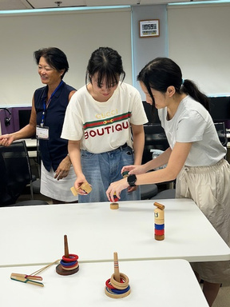
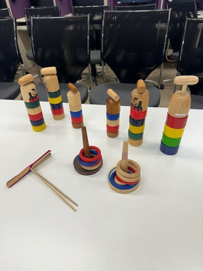
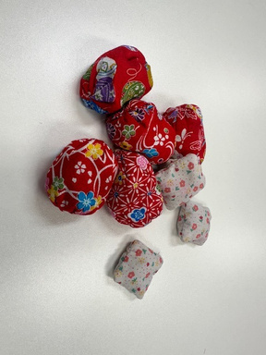
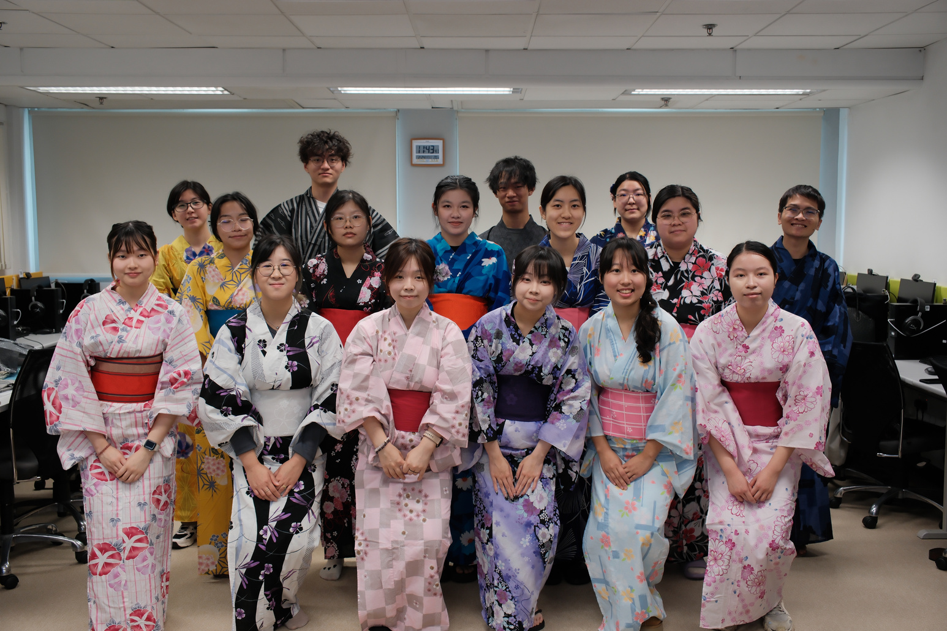
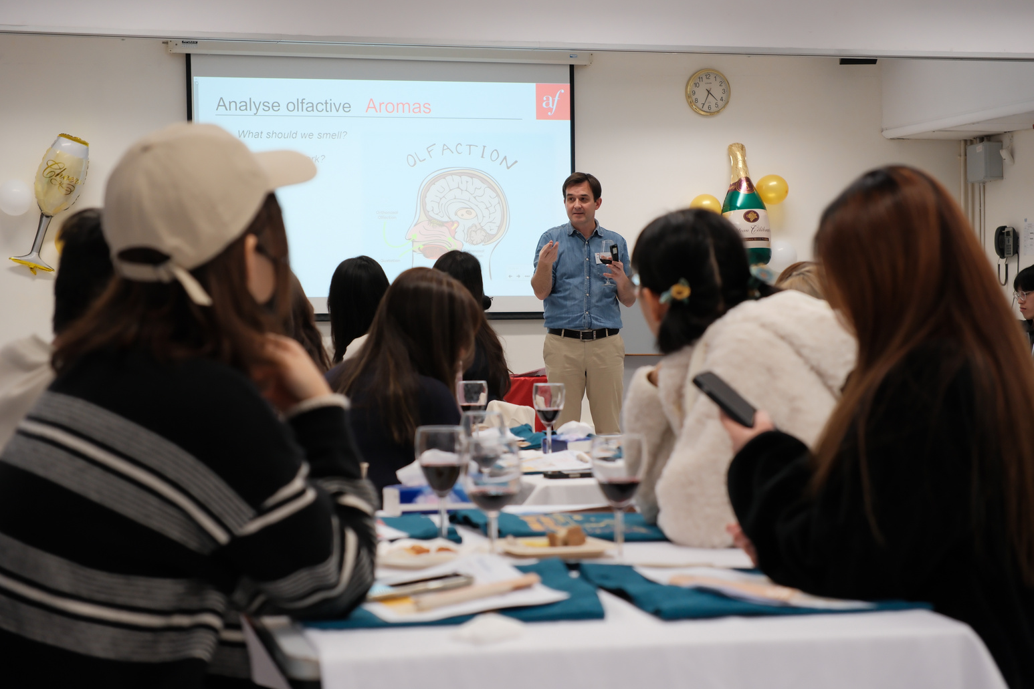
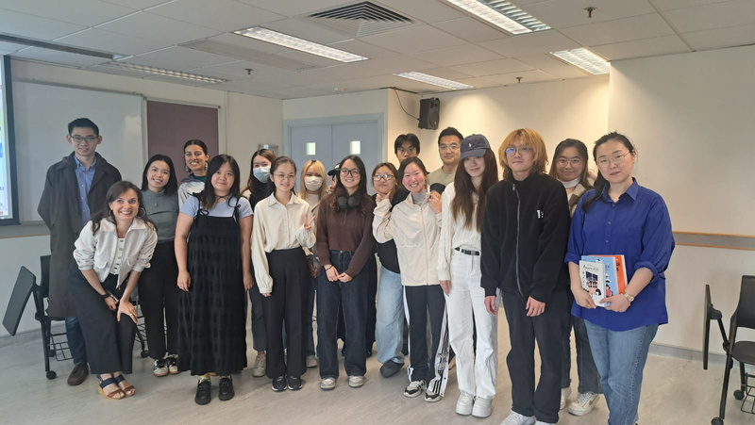


Cultural Activities
Spanish Talk - 20 years in Hong Kong
French talk by the French writer Kei Lam
Cultural Carnival
Francophone Students’ Class Visits
German Christmas Party
Japanese Workshop on “Exploring Japanese culture: Social manners and traditional Japanese toys playing

Slide 5
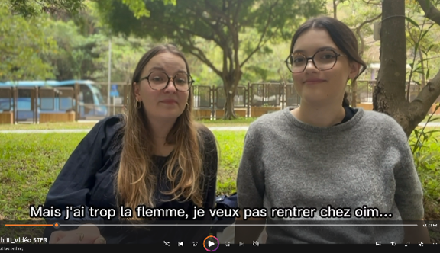
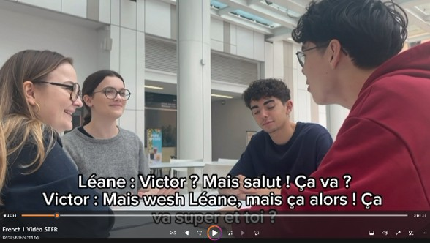
Engaging International students in material Development
This semester, we introduced additional video learning materials designed to train students' listening and speaking skills. These videos feature dialogues performed by native French-speaking students from BU, based on scripts aligned with our French course syllabuses. The use of authentic dialogues helps contextualize language learning, providing students with practical examples of language use. The involvement of BU French students in the creation process not only enriches the content but also fosters a collaborative learning environment. This initiative addresses student feedback from surveys, highlighting the importance of video/audio content in enhancing comprehension and engagement.

